Slide 1
MODERN PROCESSOR ARCHITECTURE: INTEL CORE VS AMD RYZEN VS ARM CORTEX
COMPUTER ARCHITECTURE – CSA1214
UNDER THE GUIDANCE:
DR.RADHIKA
BY:
SIVARANGJENII B
(192521375)
B.TECH IT

Slide 2
INTRODUCTION
1.What is a Processor?
A processor, also called the Central Processing Unit (CPU), is the brain of a computer. It executes instructions, performs calculations, and controls the overall operation of the system.
2.What is Processor Architecture?
Processor architecture refers to the internal design and organization of a CPU, including its instruction set, processing cores, cache memory, pipelines, and execution units.
3.Objective
Understand modern processor architectures.
Compare Intel Core, AMD Ryzen, and ARM Cortex.
Analyze their features, performance, and applications.

Slide 3
LITERATURE REVIEW
V. Carl Hamacher et al. – Computer Organization and Embedded Systems (7th Edition), which explains modern processor organization and embedded architectures.
John P. Hayes – Computer Architecture and Organization, covering processor performance, pipelining, and memory hierarchy.
Morris Mano & Rajib Mall – Computer System Architecture, providing fundamental concepts of CPU organization and instruction execution.
Recent developments in Intel, AMD, and ARM architectures have introduced multi-core processors, AI acceleration, energy-efficient designs, and advanced cache systems.

Slide 4
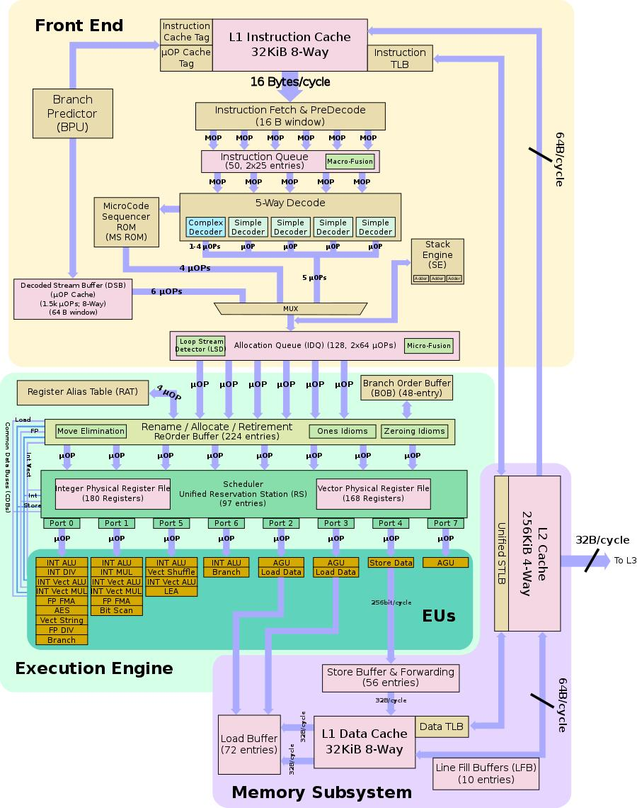
MODULE 1
Intel Core Architecture

Slide 5
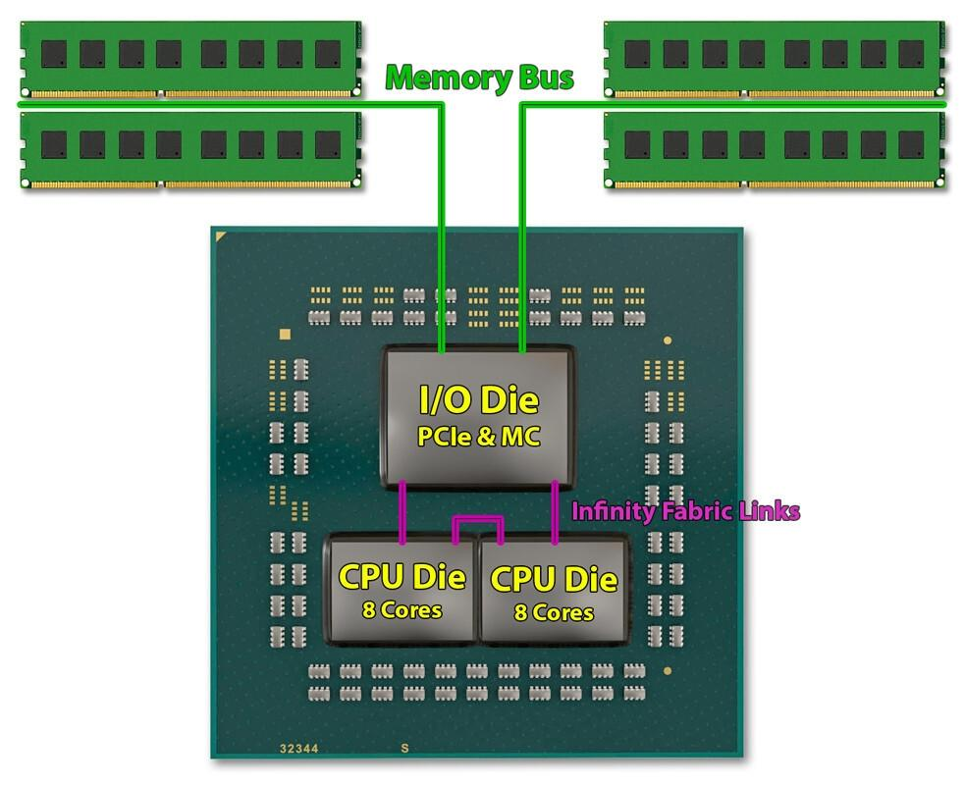
MODULE 2
AMD Ryzen Architecture

Slide 6
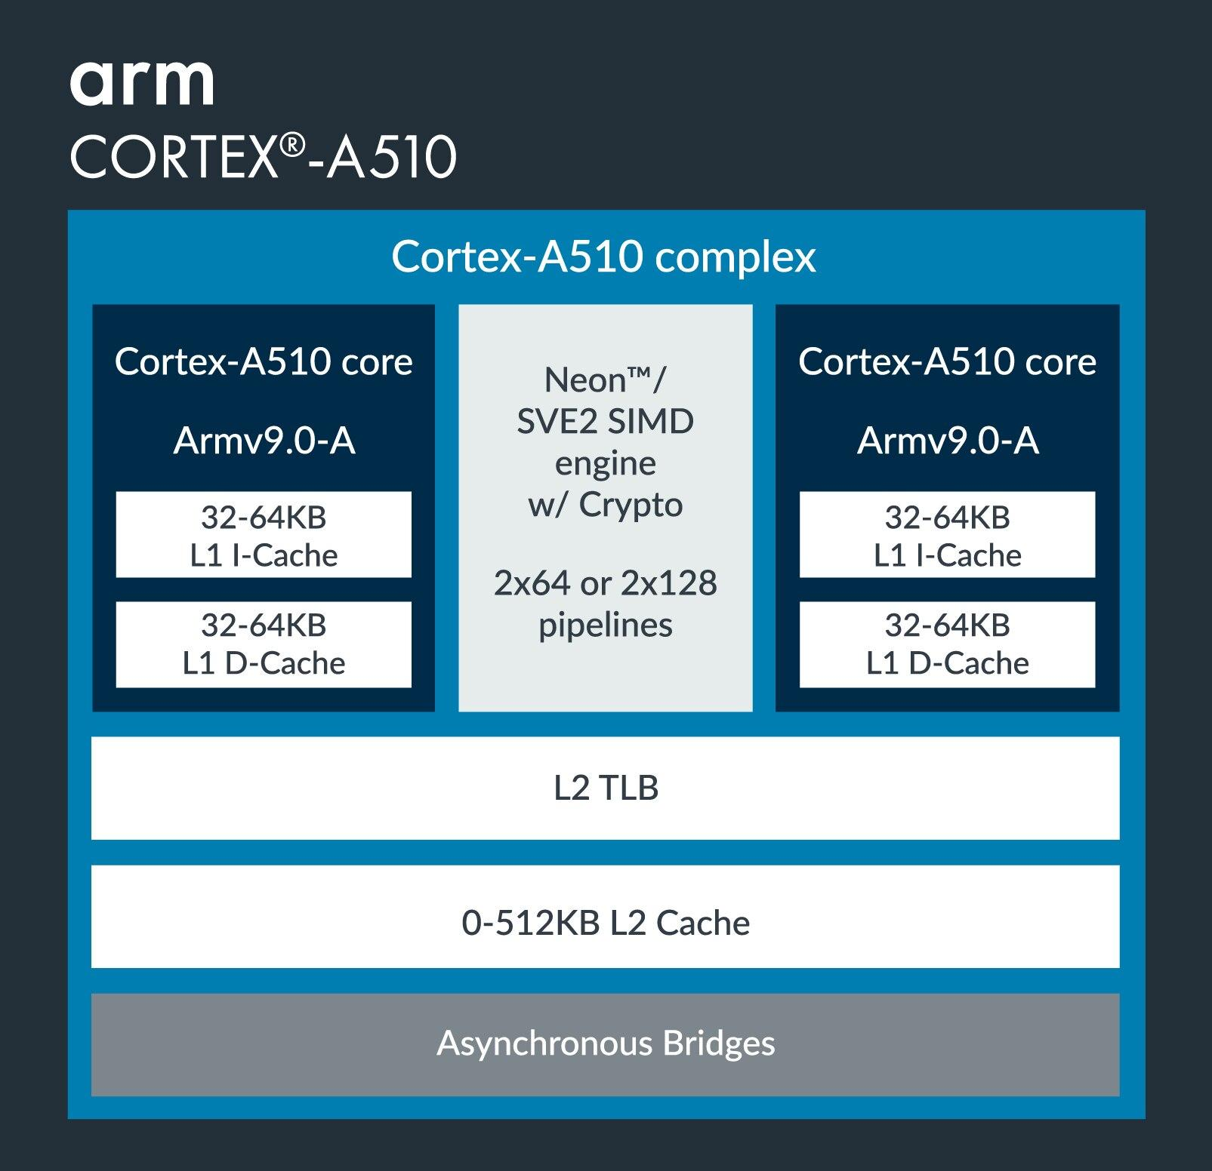
MODULE 3
ARM Cortex Architecture

Slide 7
ARCHITECTURE COMPARISON
Feature | Intel Core | AMD Ryzen | ARM Cortex
Architecture | x86-64 | x86-64 | ARM (RISC)
Performance | High | High | Moderate
Power Efficiency | Moderate | Good | Excellent
Multitasking | Good | Excellent | Good
Battery Life | Moderate | Moderate | Excellent
Applications | PCs & Laptops | Gaming & Workstations | Mobile & Embedded Systems

Slide 8
ADVANTAGES
Intel Core
Excellent single-core performance
Fast execution speed
Strong compatibility with software
AMD Ryzen
Better multi-core performance
Affordable price
Excellent multitasking
ARM Cortex
Very low power consumption
Longer battery life
Ideal for smartphones and IoT devices

Slide 9
FUTURE SCOPE
AI and Machine Learning accelerators
Hybrid processor architectures
Chiplet-based processor design
3D stacked cache technology
Quantum computing support
Ultra-low power processors
Edge computing processors
Advanced security features S
ustainable and energy-efficient computing

Slide 10
CONCLUSION
Modern processor architectures have significantly improved computing performance, efficiency, and scalability.
Intel Core offers excellent speed and strong single-core performance.
AMD Ryzen provides outstanding multi-core performance and value.
ARM Cortex delivers exceptional power efficiency for mobile and embedded devices.
The choice of processor depends on the intended application, making each architecture suitable for different computing environments.

Slide 11
REFERENCE
Hamacher, V. C., Vranesic, Z. G., & Zaky, S. G. (2024). Computer Organization and Embedded Systems (7th ed.). McGraw-Hill.
Hayes, J. P. (2023). Computer Architecture and Organization (4th ed.). McGraw-Hill.
Mano, M. M., & Mall, R. (2017). Computer System Architecture (3rd rev. ed.). Pearson.
Goankar, R. S. (2019). Microprocessor Architecture, Programming, and Applications with 8085 (6th ed.). Penram International.
Arm Ltd., Intel Corporation, & AMD. (n.d.). Official technical documentation.

